Slide 1
MediNurse Website
Prepared by hady ayoub and ahmad makii
To Dr . Ali chouman
Senior Project
Spring 2024

Slide 2
Table of Contents
Introduction
Scope
Problem & solution
Technology Constraints
Functional Requirements
Use case Diagram
Database
ER diagram
Implementation
Conclusion
Future Work

Slide 3
Introduction
In the landscape of modern healthcare, effective communication between patients and healthcare providers is fundamental to ensuring timely and comprehensive medical care.
This project is a web-based platform designed to facilitate seamless communication between patients and private nurses.
By leveraging the power of digital technology, this platform aims to improve the way patients access medical services, empowering them to request assistance, schedule appointments with private nurses from the comfort of their homes.

Slide 4
Scope
The scope of this project encompasses the development of a user-friendly website connecting patients with private nurses, enabling seamless communication and appointment scheduling.
The platform allows nurses to manage their profiles, set availability and receive requests, while patients can register, browse nurse profiles, and request appointments and medical services.

Slide 5
Problem
Solution
Without the proposed website, several challenges may occur:
Limited Access to Qualified Nurses.
Disjointed Communication Channels.
Difficulty in Tracking and Managing Patient-Nurse Interactions.
Manual and Time-Consuming Appointment Scheduling.
Creating an online website that will help nurses and patients in:
Finding qualified and nearest nurses.
Centralized Communication and Appointment Scheduling
Enhanced Nurse Visibility and Availability.
Helping nurses to find jobs.
Request nurse to some small medical services.
Request private nurses for some days.

Slide 6
Technology Constraints
Software needed: Visual studio code, Xampp, Web browser
Languages: PHP, JavaScript, html, CSS, MySQL
Frameworks & libraries: Bootstrap
Hardware: laptop.

Slide 7
Functional Requirements
01
03
04
05
06
07
08
Sign up
Sign in
Apply as Nurse
Find Nurses
Subscribe to insurance plans
02
Request appointments and services
Manage scheduling by accepting or rejecting requests
Follow the lastest medical news and interact with them

Slide 8
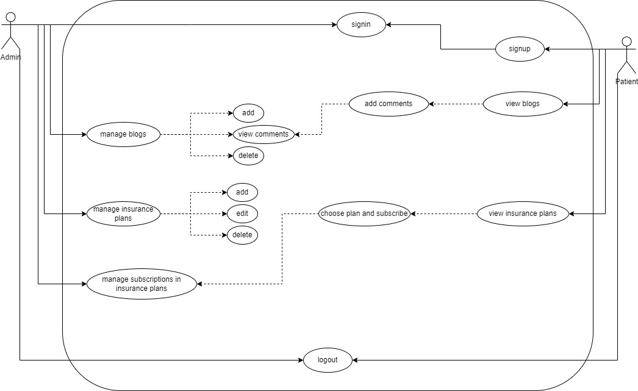
Use Case Diagram
Admin - Patient

Slide 9
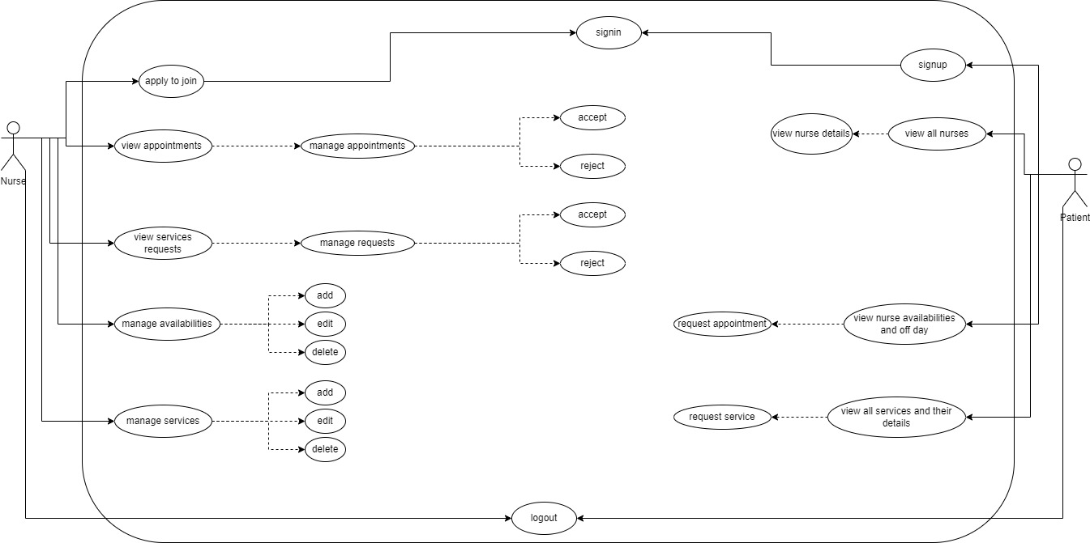
Use Case Diagram
Nurse - Patient

Slide 10
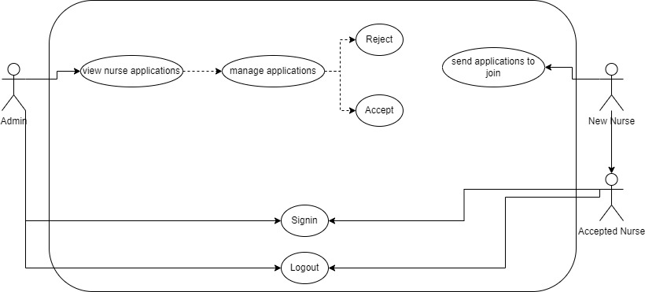
Use Case Diagram
Admin - Nurse

Slide 11
Database
The main entities of this project are:
Admin
Nurses
Patients
Nurse_applications
Medinurse_db
Insurance_plans
Availabilities
Subcriptions
Services
Blogs
Comments
Appointments
Service_requests

Slide 12
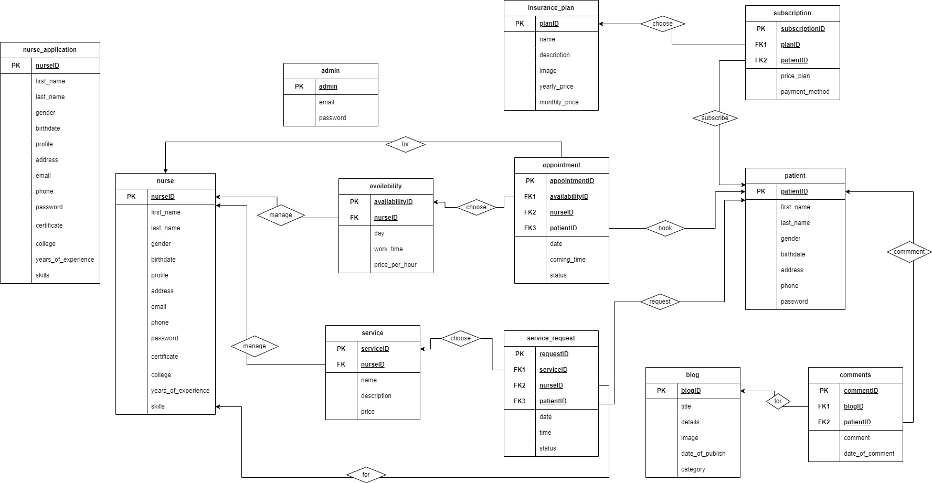
ER-DIAGRAM

Slide 13
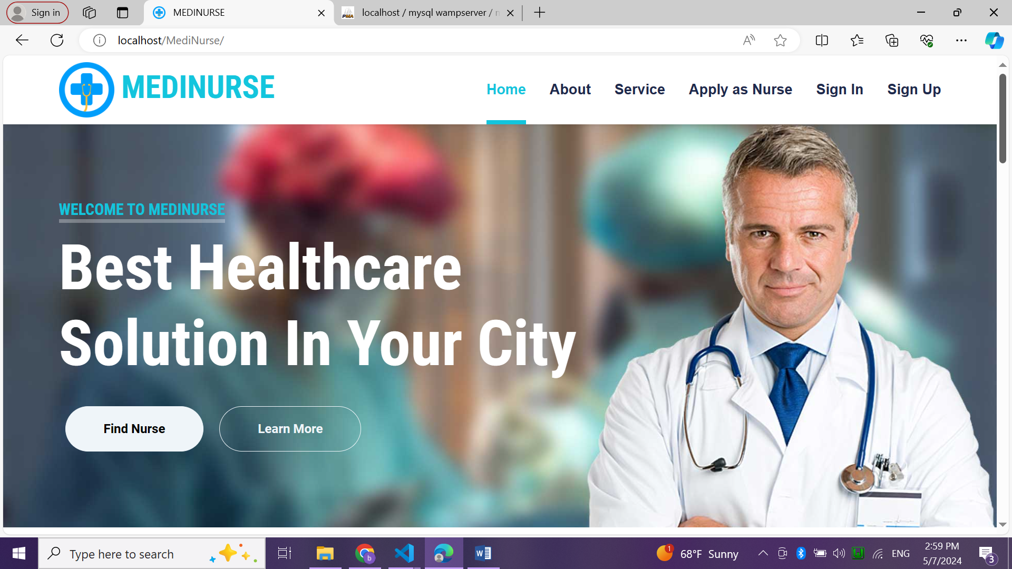
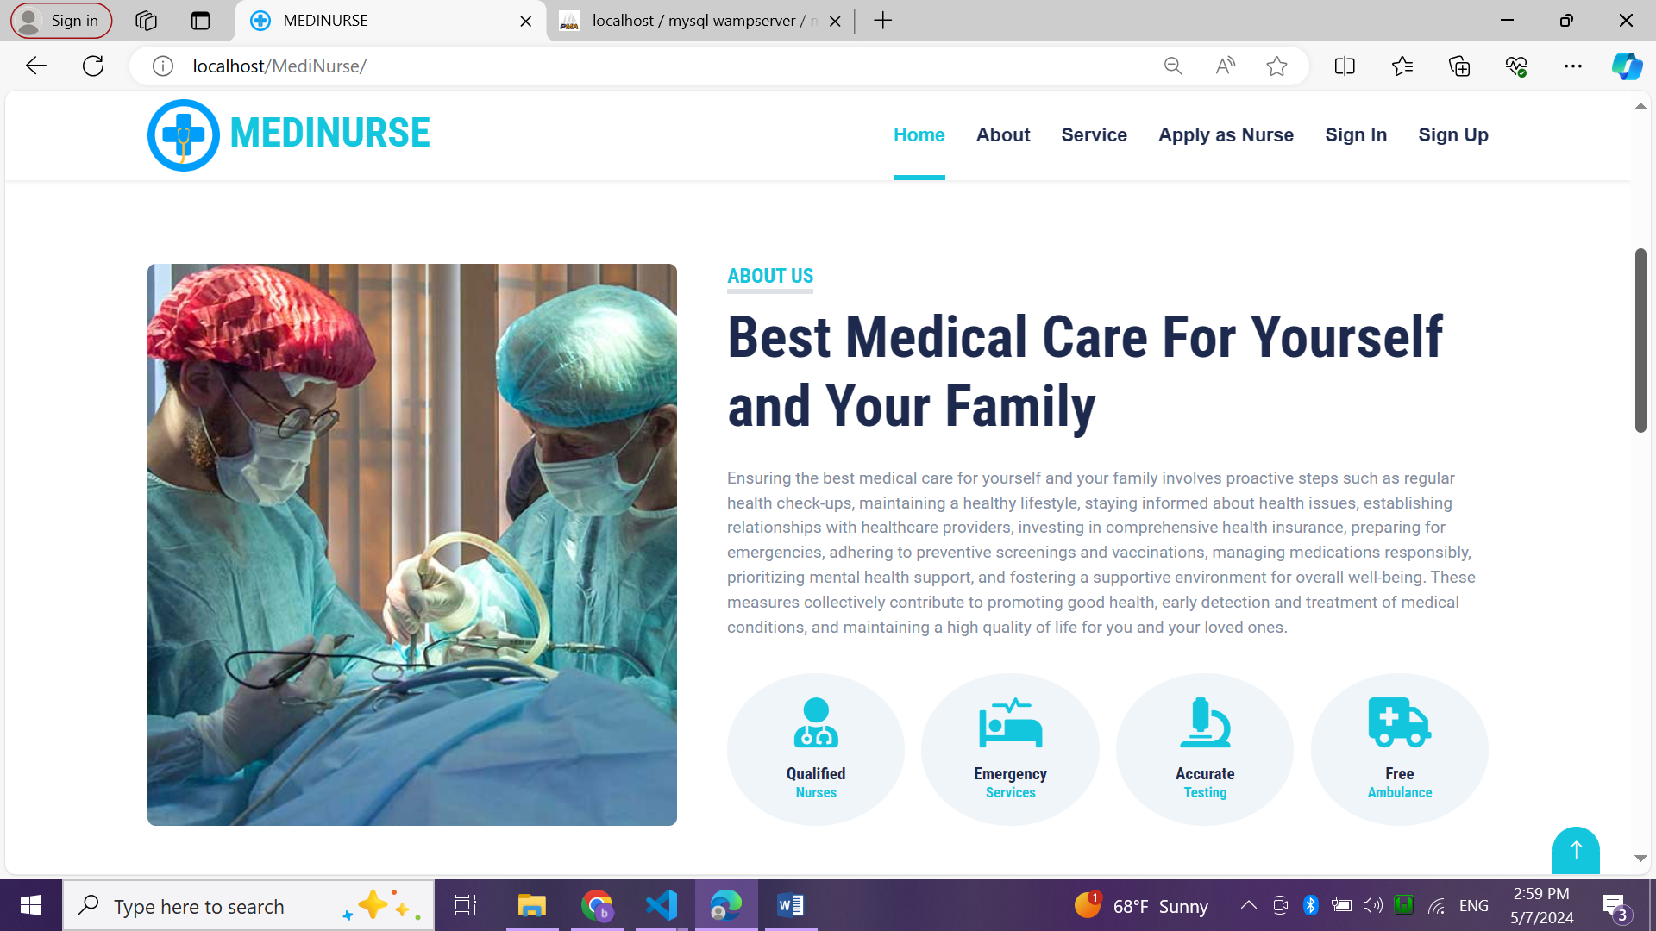
Implementation
Index page
It’s the home page for any guest.
About section gives an overview about the website.
Services section lists some of our services.
Apply as nurse allows new nurses to apply to join.
Sign In is the login page for 3 actors.
Sign Up is the registration page for new patients.

Slide 14
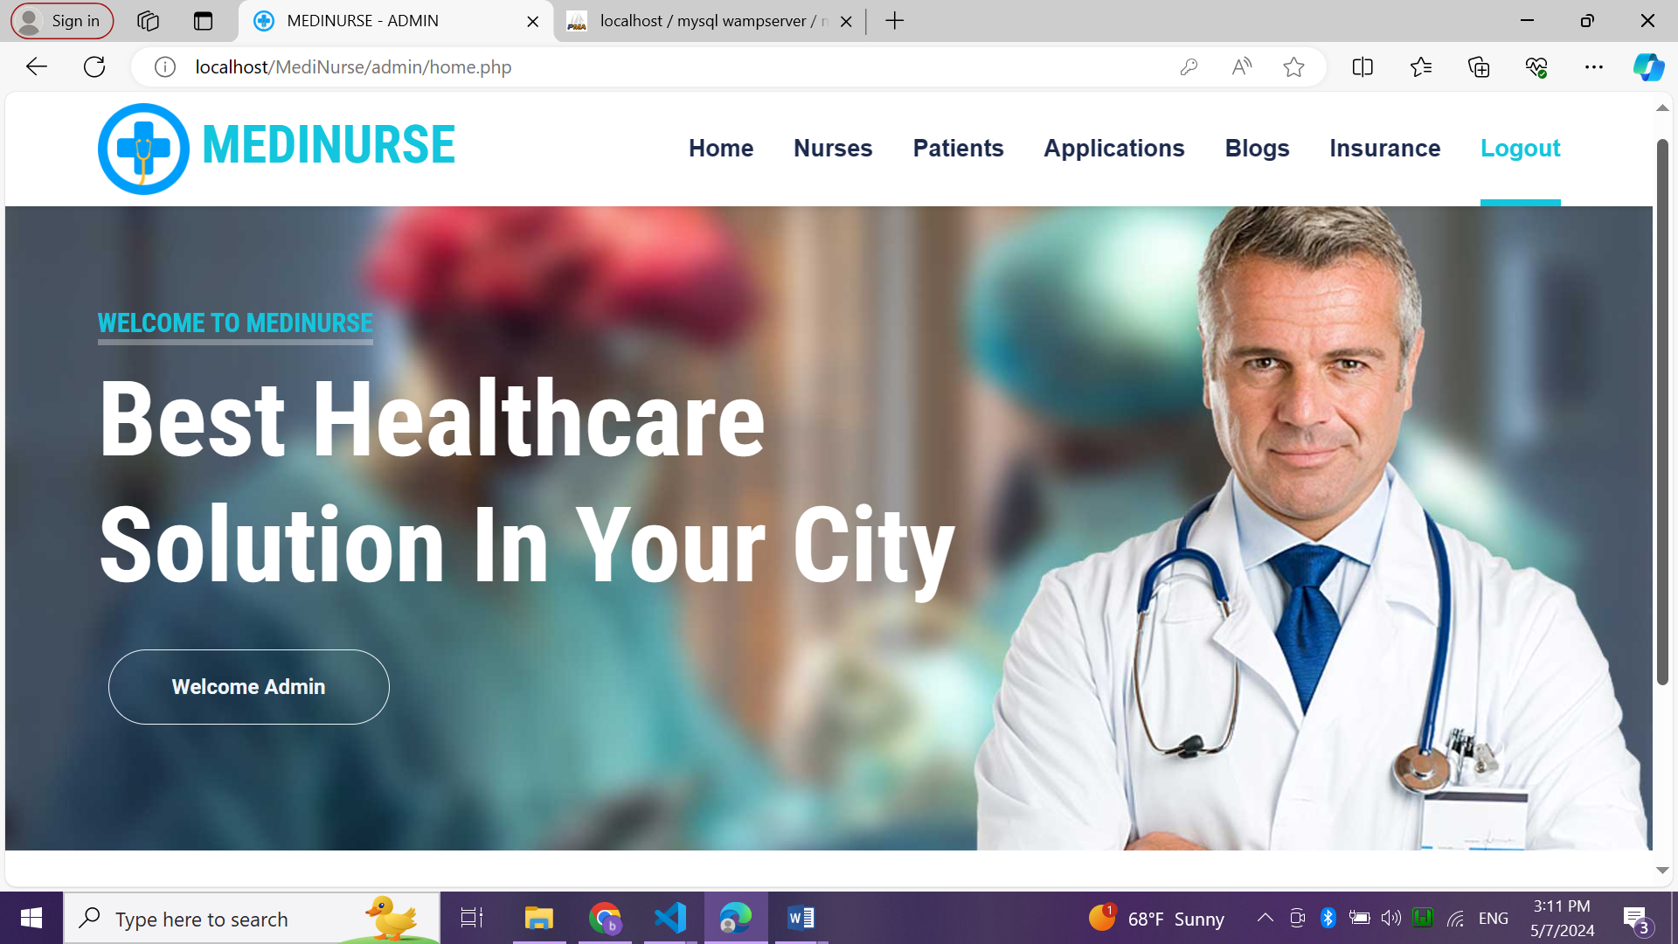
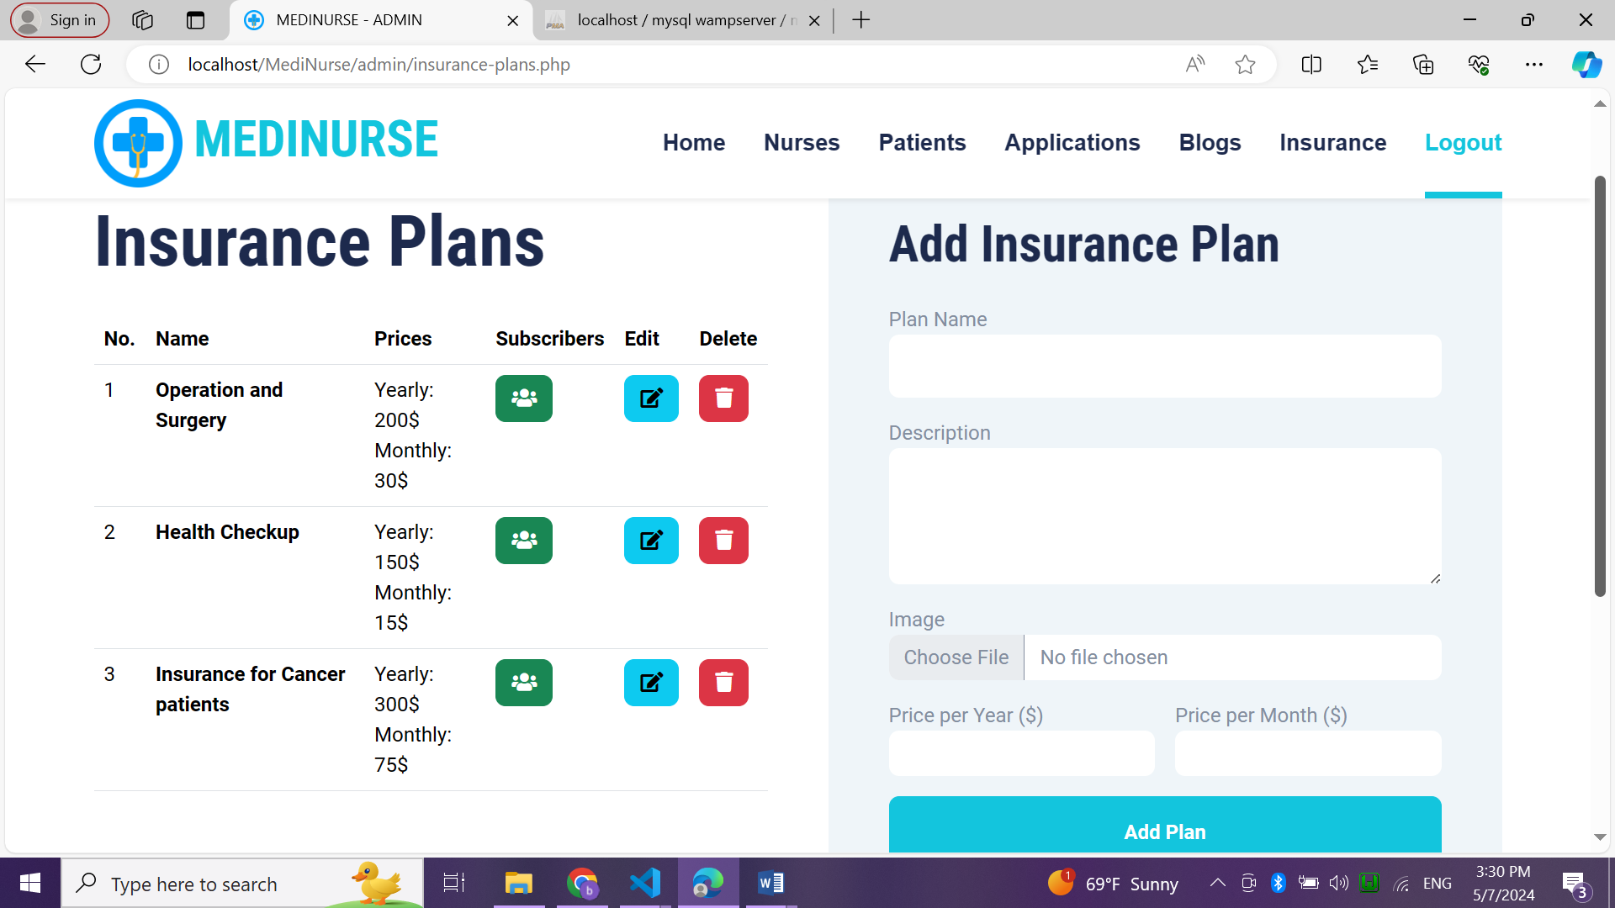
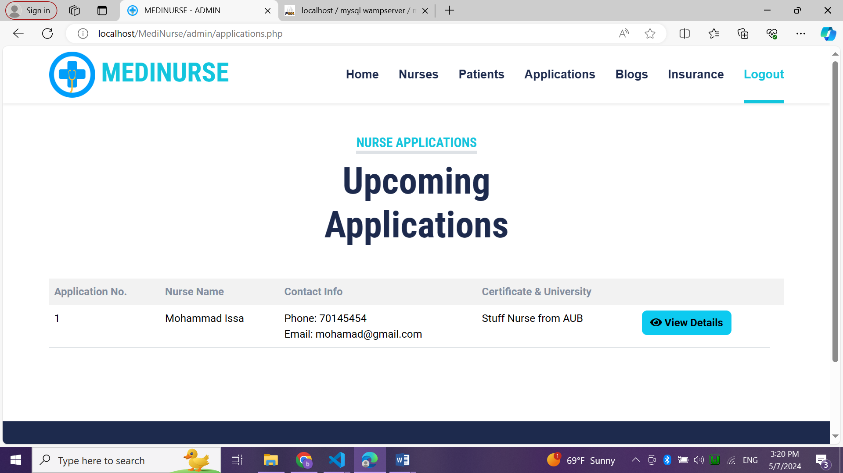
Implementation
Admin Area
It’s the admin’s dashboard where he can:
Manage all existing nurses.
View all registered patients.
Manage insurance plans.
Manage blogs.
View all comments.
View all subscribers.
Receive all nurses applications
Accept/reject nurses.

Slide 15
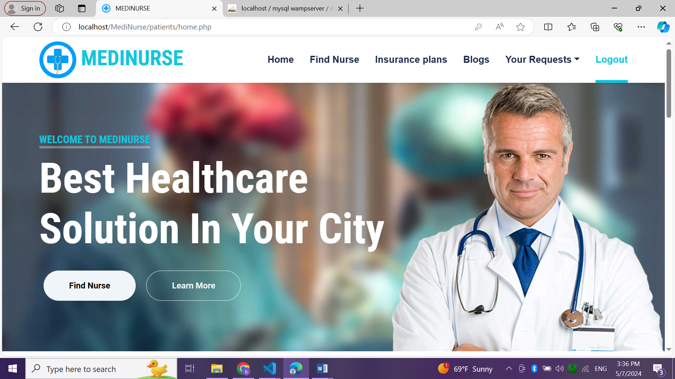
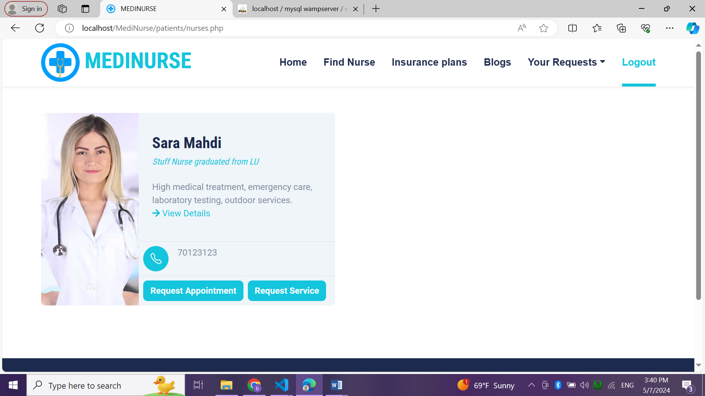
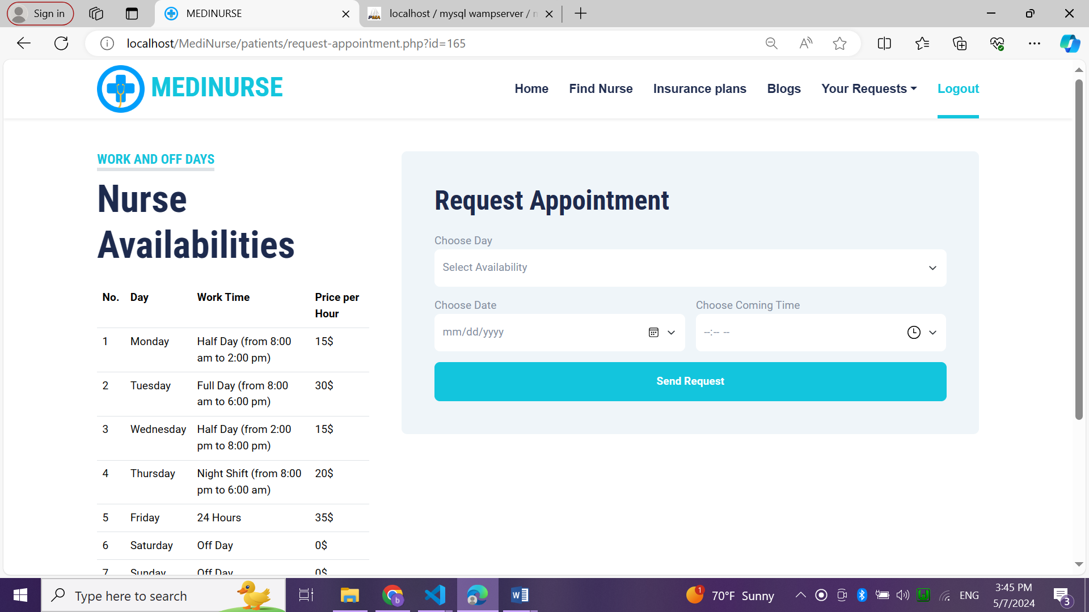
Implementation
Patient Area
It’s the patient’s dashboard where he can:
Find private nurses and check all their details.
Request appointments from nurses.
Request services from nurses.
Check and subscribe to insurance plans.
View blogs and add comments.
View all requested appointments and services.

Slide 16
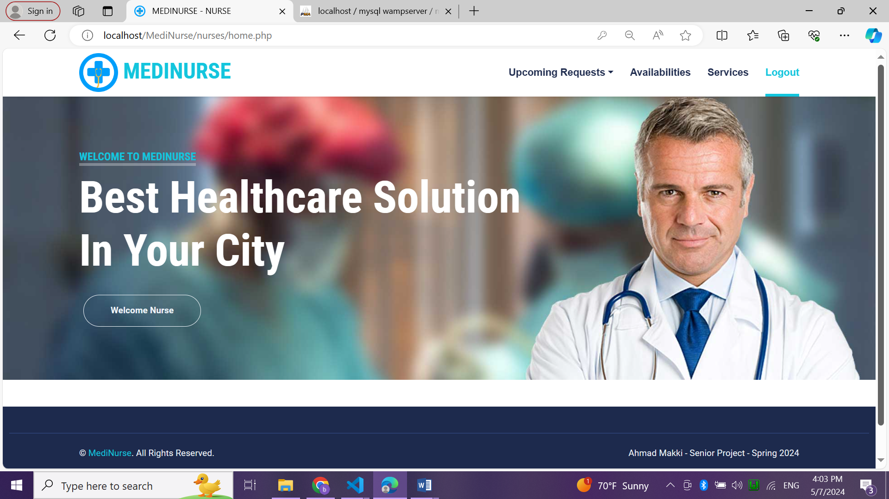
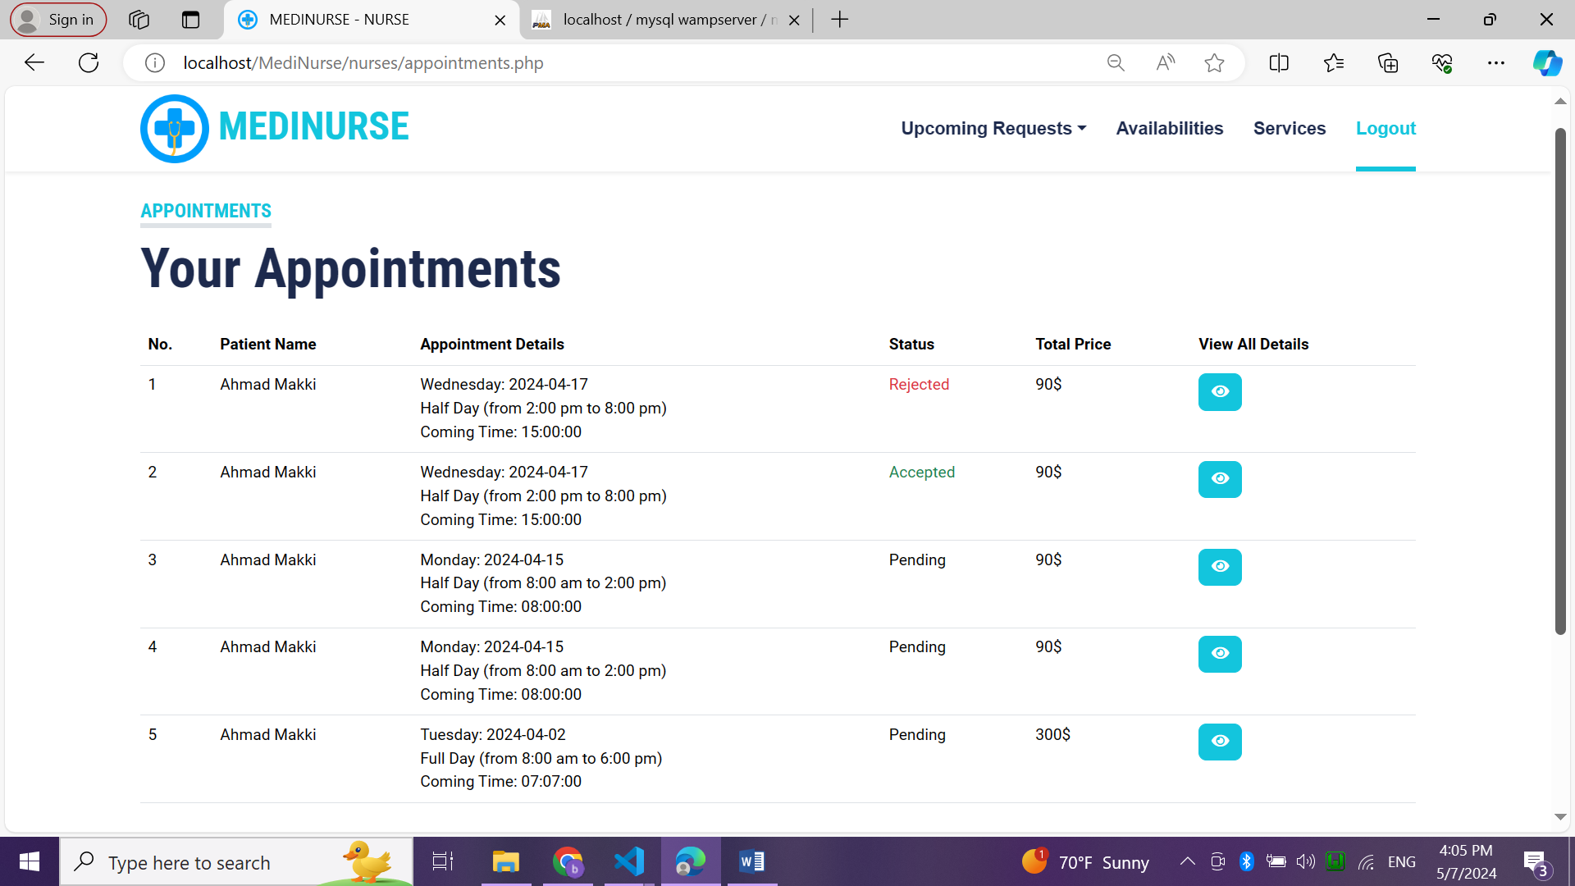
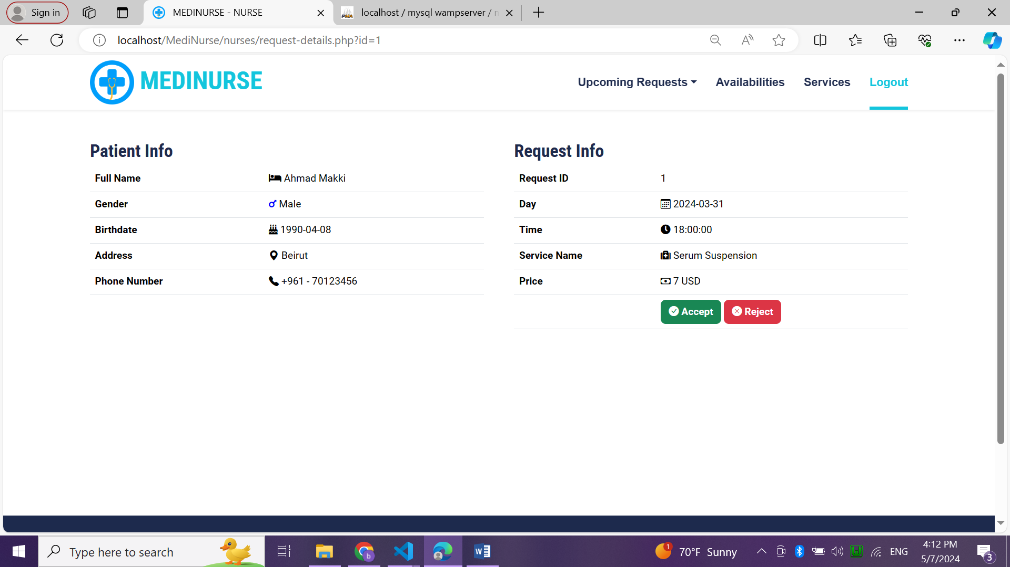
Implementation
Nurse Area
It’s the nurse’s dashboard where he can:
View all requested appointments and services from patients.
Accept or reject requests.
Manage availabilities.
Manage services.

Slide 17
Conclusion
In conclusion, the development of a web-based platform connecting patients with private nurses offers significant advantages in improving the accessibility, efficiency, and quality of healthcare services.
By addressing the challenges associated with traditional methods of patient-nurse communication and appointment scheduling, the platform:
Enhances patient satisfaction.
Promotes proactive health management.
Optimizes resource utilization within the healthcare ecosystem.

Slide 18
Future Work
01
02
03
Develop the privacy of this project to be secure by introducing the encryption system of all data sent.
Implement mobile application for patients to be more useful and easier for people.
Integrate real-time communication between patients and private nurses.

Slide 19
Thank You

